Slide 1


GUYUS REAL ESTATE OPERATIONS AUTOMATION AND ACTIVITY ANALYSIS

Slide 2
Introduction
Guyus Real Estate: A renowned real estate company with a sprawling portfolio.
Portfolio: Spans residential, commercial, and land sales across multiple locations.
Strengths:
Deep Market Knowledge: Guyus Real Estate boasts extensive insights into local real estate markets.
Exceptional Customer Service: Prioritizes client satisfaction and personalized assistance.
Wide Property Options: Offers diverse choices for both buyers and sellers.
Challenge: Struggling with reporting and analytics.

Slide 3
Problem Statement
Objective: Enhance reporting and analytical processes.
Goal: Improve decision-making, efficiency, and competitiveness.

Slide 4
Project Goals
Assess
Assess Current State:
Conduct an in-depth analysis of existing reporting and analytical workflows.
Identify pain points, bottlenecks, and areas for improvement.
Strengthen
Strengthen Data Infrastructure:
Established a robust data storage, retrieval, and processing systems.
Implement a centralized data warehouse for seamless data access.
Ensured data security and compliance.
Standardize
Standardize Reporting Practices:
Defined clear reporting templates and guidelines.
Established KPIs (Key Performance Indicators) for different business units.
Regularly review and update reporting formats.
4. Automate Routine Reports:
We leverage technology to automate repetitive reporting tasks.
Used Power BI, to create our visuals.
Freed up resources for more strategic analysis.
5. Enhance Data Visualization:
Created visually appealing dashboards for executives and teams.
Visualize trends, market insights, and performance metrics.
Enable quick decision-making based on real-time data.

Slide 5
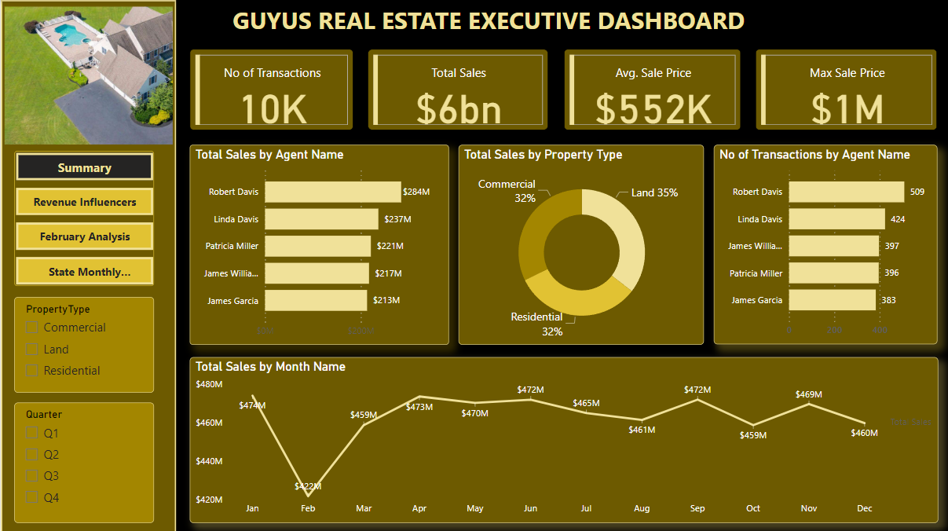

Slide 6
Key Performance Metrics
Overall Performance
Total Sales: $6 billion.
Number of Transactions: 10,000.
Average Sale Price: $552,000.
Max Sale Price: $1 million.
Actionable Insights:
High-Value Sales Strategy:
Focus on increasing average sale prices by targeting premium properties.
Promote luxury and high-value listings to boost revenue per transaction.
Transaction Volume Efficiency:
Identify and streamline processes for high-frequency transactions to sustain efficiency and reduce operational costs.

Slide 7
State-Level Insights
Actionable Insights:
Maximize Texas Opportunities:
Allocate more resources and marketing efforts to capitalize on the TX market dominance.
Explore partnerships with local developers for Land and Commercial property deals.
Revitalize Underperforming States:
Conduct market research in PA and AZ to identify buyer barriers (e.g., pricing, inventory, marketing gaps).
Launch state-specific campaigns to boost visibility and attract buyers.
Leverage California and New York:
Enhance focus on these mid-tier states by aligning property offerings with buyer preferences (e.g., luxury Residential in CA, high-value Commercial in NY).
Top Performing State: Texas (TX)
Impact: Properties in Texas significantly increase average total sales by $5.4M compared to other states.
Key Contribution: TX leads in average sales, driven by strong demand for Land and Commercial properties.
Mid-Tier States
California (CA): High potential, performing just below Texas. Likely driven by Residential and Commercial property demand.
New York (NY): Consistent performance but lags behind TX and CA.
Underperforming States
Pennsylvania (PA) and Arizona (AZ): Lower average sales suggest untapped market potential or limited demand.

Slide 8
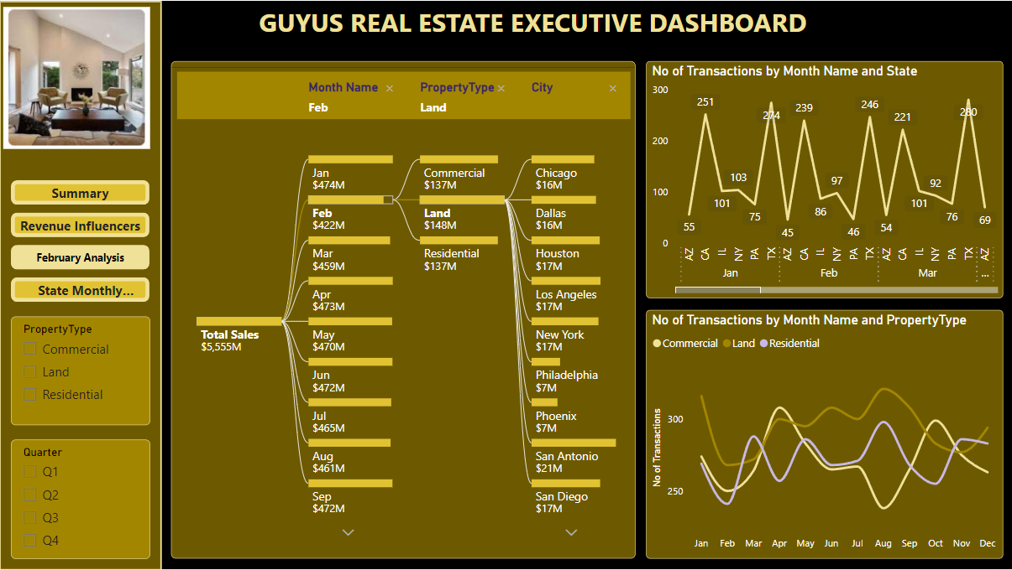

Slide 9
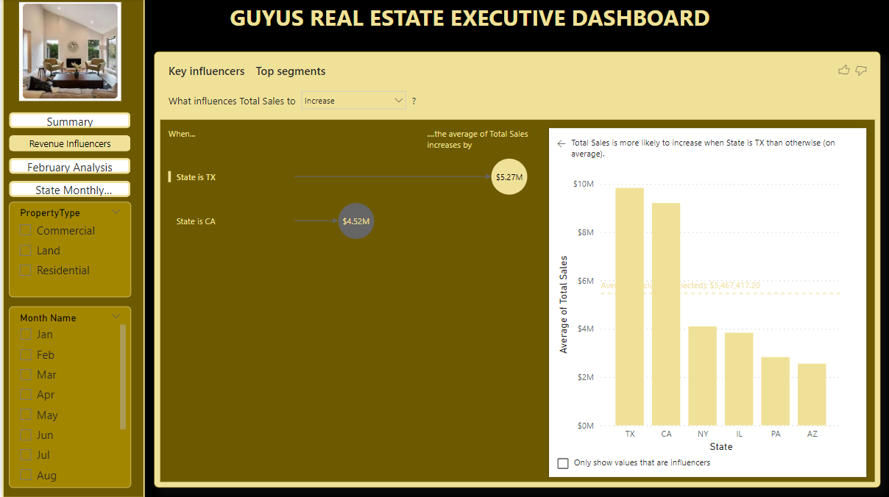

Slide 10
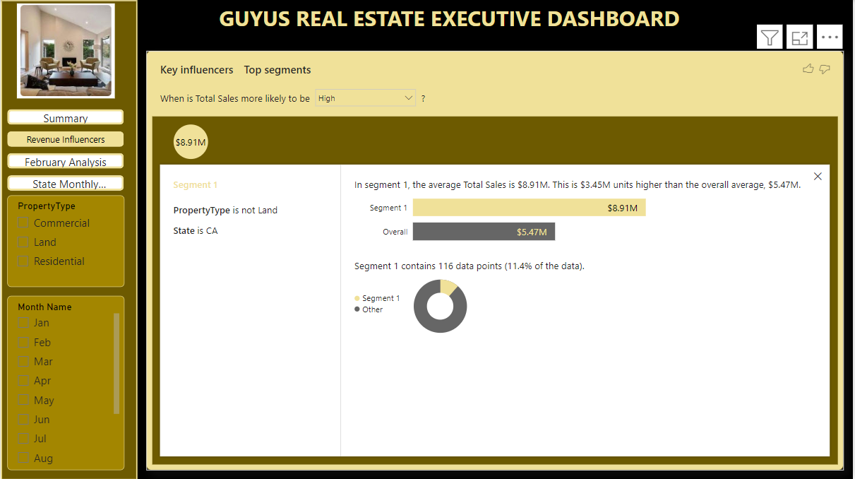

Slide 11
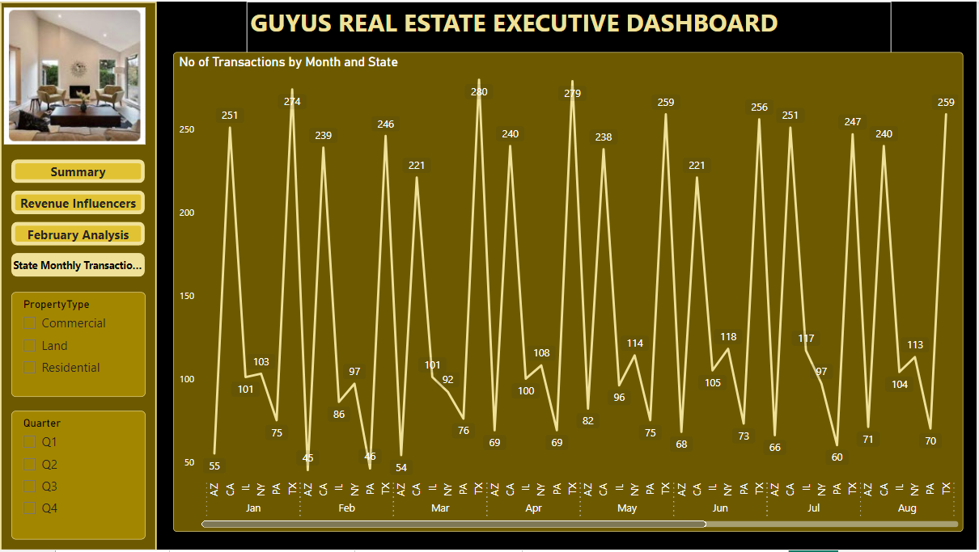

Slide 12

Recommendations
Empower Analysts:
Provide training on advanced analytics tools like Power BI and Tableau.
Encourage data exploration.
Foster a data-driven culture within the organization.
Collaborate Across Departments:
Break silos by involving Sales, Marketing, and Finance teams.
Share insights and collaborate on cross-functional projects.
Align reporting goals with overall business objectives.
Monitor and Iterate:
Regularly monitor reporting effectiveness.
Collect feedback from stakeholders.
Continuously refine processes based on insights.

Slide 13


Recommendations
Improved Decision-Making: Timely, accurate data drives informed choices.
Efficiency Gains: Automation reduces manual effort.
Competitive Edge: Better insights lead to competitive advantage.
Remember, success lies in adapting to changing market dynamics and staying agile. Guyus Real Estate can transform its reporting and analytics landscape to thrive in the ever-evolving real estate industry.

